Slide 1
A Technical Overview of the .ng Registry
Ope Odusan
Chief Operating Officer
Nigerian Internet Registration Association
oodusan@nira.org.ng
http://www.nira.org.ng
Tel: 0808 208 2766

Slide 2
What is a Domain Name ?
In the Beginning ……
US Defence Dept. DARPA Project started the Internet.
Computers use Transmission Control Protocol (TCP)- Internet Protocol (IP) Addresses to Communicate.
Humans Prefer letters. IP 108.163.163.202 is much more difficult than domain name : odusan.name.ng, hence the birth of Domain Name System (DNS).
Domain Name is an identification string that defines a realm of administrative autonomy, authority or control on the internet.
A Domain Name represent an Internet Protocol resource.
Domain Name are organized in subordinate levels (subdomains) of the DNS Root domain. Top Level Domain (TLDs) represent the first level, this include generic top-level domains (gTLD) i.e. .com, .net, etc and the country code top-level domains ccTLD like .ng

Slide 3
NiRA-Background
.ng is Nigeria’s country code, the Nigerian identification string on the internet.
This important national resource is managed by Nigeria Internet Registration Association (NIRA)
NiRA's was established after the Delegation of .ng to Nigeria by USA based ICANN (Internet Corporation for Assigned Name and Numbers) by the National Information Technology Development Agency (NITDA).
The Nigeria Internet Registration Association (NiRA) was founded on March 23, 2005 as a stakeholder-led organisation, registered Trustee charged with the management of the nation's Country Code Top Level Domain Name (ccTLD), .ng..
NiRA is headed by an Executive President, Mrs Mary Uduma who heads the 8 members executive board and Dr. Adeola Odeyemi, Chairman, 9 Member Board of Trustee.

Slide 4
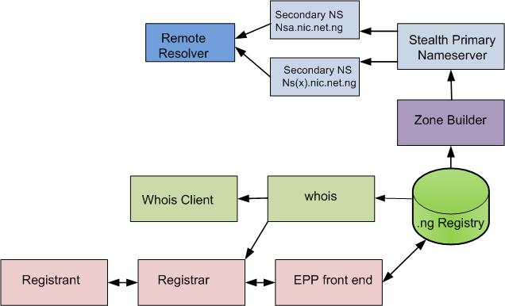
The .ng Registry Design
3R Registry Model
Public WHOIS server on port 43
Public WHOIS web interface
EPP interface for the registrars
Escrow backup with Cocca
Stealth Primary Server
SSH with user & IP restrictions

Slide 5
Registry Network Design
Redundant Site
Fiber and Radio linking the two sites using VPN channel
Multiple ISPs with diversity in uplink transit provider
Multiple replication of registry Database with all nodes available
Onsite and offsite backup system
Multiple firewalls-stateful & stateless with Intrusion Detection System
Dual authentication to all registrars into the registry: login details with IP restrictions.

Slide 6
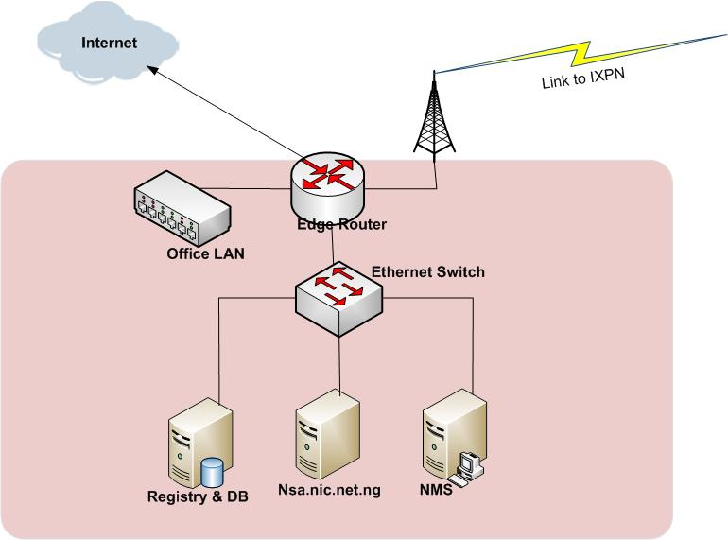
The .ng ccTLD network Architecture
The Registry
CentOS Linux
Cocca registry software (web & EPP)
PostgreSQL Data Base software
Bind DNS software
Primary Stealth DNS
Nsa.nic.net.ng
Open BSD
Bind DNS Software
NMS
Tembria Server Monitor
Paessler PRTG
Kayako Helpdesk
Standby Router & Switch

Slide 7
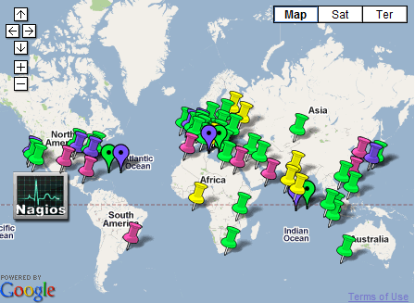
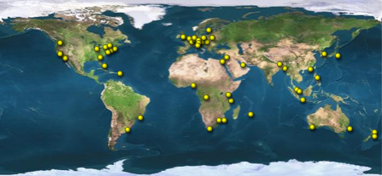
Secondary Name Servers
ns1.nic.net.ng 194.0.1.29 I
Internet Computer Bureau
ns2.nic.net.ng 204.61.216.40
(PCH)
ns3.nic.net.ng 208.78.70.93
Dynamic Network Services (USA)
ns4.nic.net.ng 204.13.250.93
Dynamic Network Services (USA)
nsa.nic.net.ng 41.222.79.3
Nigeria

Slide 8
Network Monitoring

Slide 9
Registry Power Design
Motorized Automatic Voltage Regulators (AVR) for each power source
Double Power source
Dual Automatic Transfer Switch (ATS)
Multiple Power packs in each equipment
Remote monitoring of power, with ability shutdown devices remotely

Slide 10
Summary
Domain Name makes it easier for Humans to locate Internet Protocol Resource, i.e. website, email address, blogs etc.
.ng is the unique string for Nigeria just like our official currency is (₦) Naira
.gov.ng is the approved official domain name for Nigerian Government.
All MDAs need to use a .gov.ng domain name string for websites and email addresses.
All Civil servants should have email address with domain name that ends with .gov.ng
NIRA has implemented a robust, distributed, secure and stable Registry Infrastructure.

